Slide 1
Lab_05
Tap Changing Transformer

Slide 2
Tap Changing Transformer
The purpose of a tap changer is to regulate the output voltage of a transformer. It does this by altering the number of turns in one winding and thereby changing the turns ratio of the transformer.

Slide 3
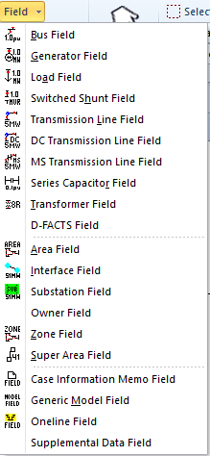

Slide 4
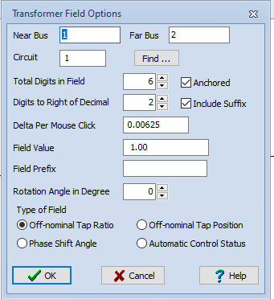

Slide 5
